Slide 1
CSE408 Brute Force(String Matching, Closest pair, Convex hull,Exhaustive,Voronori diagrams
Lecture # 7&8

Slide 2
Brute Force
A straightforward approach, usually based directly on the problem’s statement and definitions of the concepts involved

Slide 3
Brute-Force String Matching
pattern: a string of m characters to search for
text: a (longer) string of n characters to search in
problem: find a substring in the text that matches the pattern
Brute-force algorithm
Step 1 Align pattern at beginning of text
Step 2 Moving from left to right, compare each character of pattern to the corresponding character in text until
all characters are found to match (successful search); or
a mismatch is detected
Step 3 While pattern is not found and the text is not yet exhausted, realign pattern one position to the right and repeat Step 2

Slide 4
Examples of Brute-Force String Matching
Pattern: 001011 Text: 10010101101001100101111010
Pattern: happy Text: It is never too late to have a happy childhood.

Slide 5
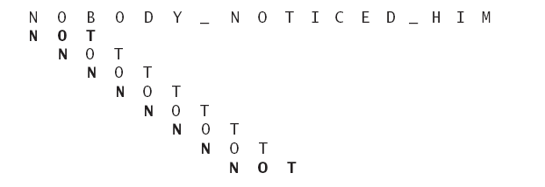

Slide 6
Closest-Pair Problem
Find the two closest points in a set of n points (in the two-dimensional Cartesian plane).
Brute-force algorithm
Compute the distance between every pair of distinct points
and return the indexes of the points for which the distance is the smallest.
Notes:
Draw example.

Slide 7
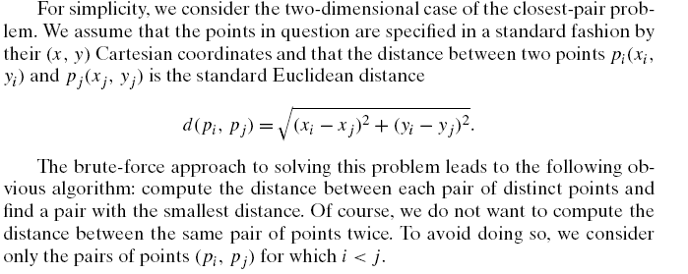

Slide 8
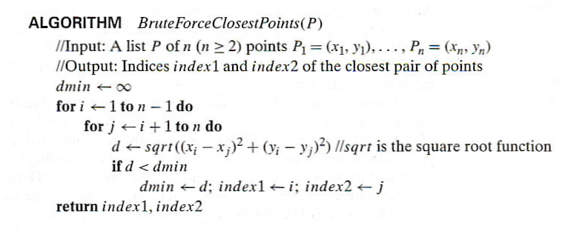
Closest-Pair Brute-Force Algorithm (cont.)
Efficiency:
How to make it faster?
Θ(n^2) multiplications (or sqrt)
Using divide-and-conquer!
Notes:
The basic operation of the algorithm is computing the Euclidean distance between two points.
The square root is a complex operation who’s result is often irrational, therefore the results
can be found only approximately. Computing such operations are not trivial. One can avoid
computing square roots by comparing distance squares instead.

Slide 9
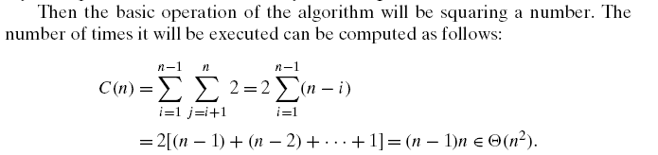

Slide 10

Convex Hull Problem

Slide 11
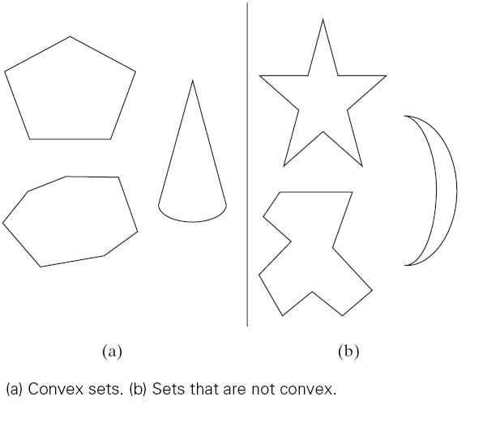

Slide 12
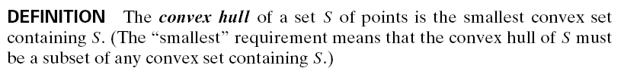

Slide 13
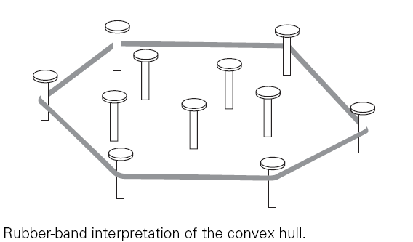

Slide 14
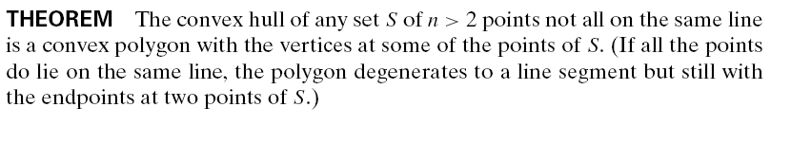

Slide 15
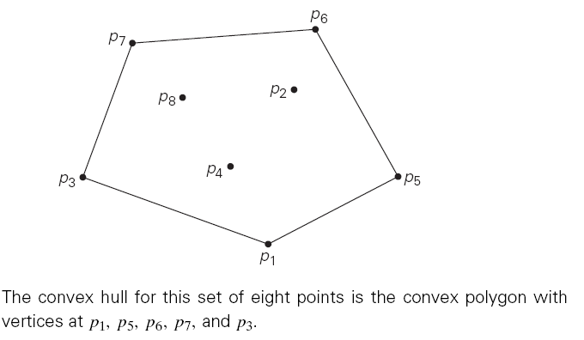

Slide 16
The convex-hull problem is the problem of constructing the convex hull for a given set S of n points
To solve it, we need to find the points that will serve as the vertices of the polygon in question.
Mathematicians call the vertices of such a polygon “extreme points.”
By definition, an extreme point of a convex set is a point of this set that is not a middle point of any line segment with endpoints in the set.

Slide 17
how can we solve the convex-hull problem in a brute-force manner?
Nevertheless, there is a simple but inefficient algorithm that is based on the following observation about line segments making up the boundary of a convex hull
a line segment connecting two points pi and pj of a set of n points is a part of the convex hull’s boundary if and only if all the other points of the set lie on the same side of the straight line through these two points

Slide 18
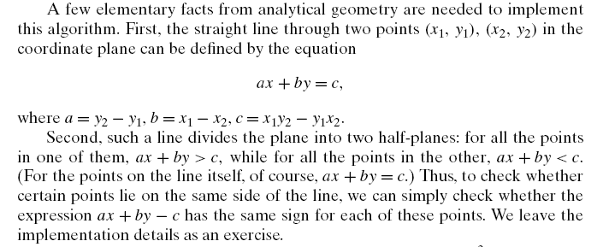

Slide 19
Brute-Force Strengths and Weaknesses
Strengths
wide applicability
simplicity
yields reasonable algorithms for some important problems (e.g., matrix multiplication, sorting, searching, string matching)
Weaknesses
rarely yields efficient algorithms
some brute-force algorithms are unacceptably slow
not as constructive as some other design techniques

Slide 20
Exhaustive Search
A brute force solution to a problem involving search for an element with a special property, usually among combinatorial objects such as permutations, combinations, or subsets of a set.
Method:
generate a list of all potential solutions to the problem in a systematic manner (see algorithms in Sec. 5.4)
evaluate potential solutions one by one, disqualifying infeasible ones and, for an optimization problem, keeping track of the best one found so far
when search ends, announce the solution(s) found

Slide 21
Example 1: Traveling Salesman Problem
Given n cities with known distances between each pair, find the shortest tour that passes through all the cities exactly once before returning to the starting city
Alternatively: Find shortest Hamiltonian circuit in a weighted connected graph
Example:
2
a
b
5
3
8
4
c
d
7
How do we represent a solution (Hamiltonian circuit)?

Slide 22
TSP by Exhaustive Search
Tour Cost
a→b→c→d→a 2+3+7+5 = 17
a→b→d→c→a 2+4+7+8 = 21
a→c→b→d→a 8+3+4+5 = 20
a→c→d→b→a 8+7+4+2 = 21
a→d→b→c→a 5+4+3+8 = 20
a→d→c→b→a 5+7+3+2 = 17
Efficiency:
Θ((n-1)!)
Chapter 5 discusses how to generate permutations fast.

Slide 23
Final Comments on Exhaustive Search
Exhaustive-search algorithms run in a realistic amount of time only on very small instances
In some cases, there are much better alternatives!
Euler circuits
shortest paths
minimum spanning tree
assignment problem
In many cases, exhaustive search or its variation is the only known way to get exact solution
The Hungarian method runs in O(n^3) time.

Slide 24
Vornoi diagram
The partitioning of a plane with points into convex polygons such that each polygon contains exactly one generating point and every point in a given polygon is closer to its generating point than to any other.
A Voronoi diagram is sometimes also known as a Dirichlet tessellation. The cells are called Dirichlet regions, Thiessen polytopes, or Voronoi polygons.

Slide 25
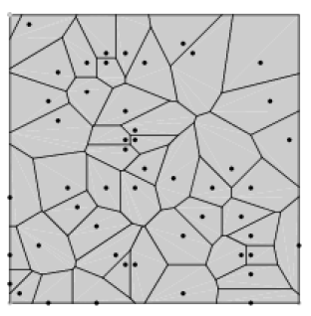

Slide 26
Voronoi diagrams were considered as early at 1644 by René Descartes and were used by Dirichlet (1850) in the investigation of positive quadratic forms.
They were also studied by Voronoi (1907), who extended the investigation of Voronoi diagrams to higher dimensions.
They find widespread applications in areas such as computer graphics, epidemiology, geophysics, and meteorology

